Slide 1

1103 Database Project
Taryn CAIL

Slide 2
Introduction
I created a Music database that allows the user to input songs, playlists and artists as well as manipulate their individual attributes.

Slide 3
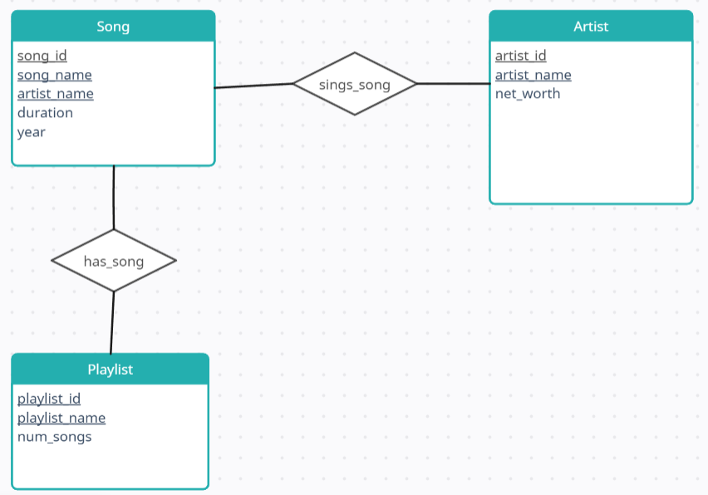
ER Diagram

Slide 4
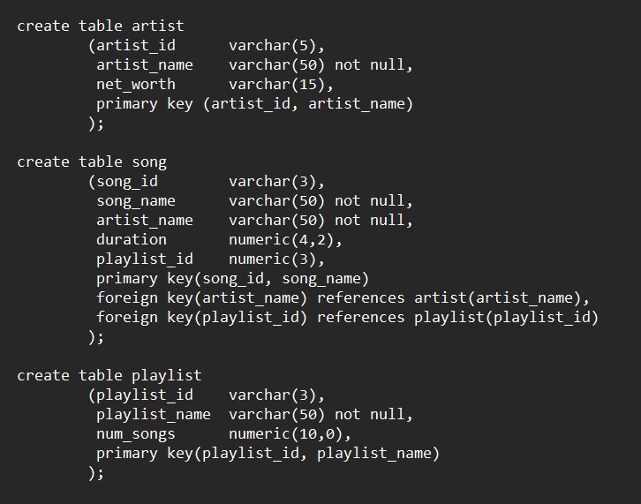

DDL - Entities

Slide 5
DDL – Entities Explanation - Artist
To identify each individual artist, I needed not only a name but ID in case there of duplicates.
The artist ID is a max of 5 characters long.
The artists name can be up to 50 characters and cannot be null, meaning every artist or band needs to have a name.
I added net_worth as an extra characteristic to give description to each artist.
The primary keys are artist_id and artist_name which can identify each individual artist safe of duplicates.

Slide 6
DDL – Entities Explanation - Song
For the song entity, an ID column was needed in case of duplicates. The ID is three characters long.
The song_name can be up to 50 characters long and can not be null because every song needs a title.
The artist_name is also a given characteristic to link the artist or band with the song.
For added description the duration of the song and playlist_id is also given.
The primary keys are song_id and song_name which distinguishes each individual song.
The foreign keys are artist_name and playlist _id which connect the song to artist and playlist.

Slide 7
DDL – Entities Explanation - Playlist
To distinguish playlists that might have the same name a playlist_id was implemented which is three characters long.
The playlist can be given a name up to 50 characters long and cannot be null.
The playlist also has a num_songs column that indicates the number of songs.
The primary keys are the playlist_id and playlist_name because they distinguish each individual playlist without duplicates.

Slide 8
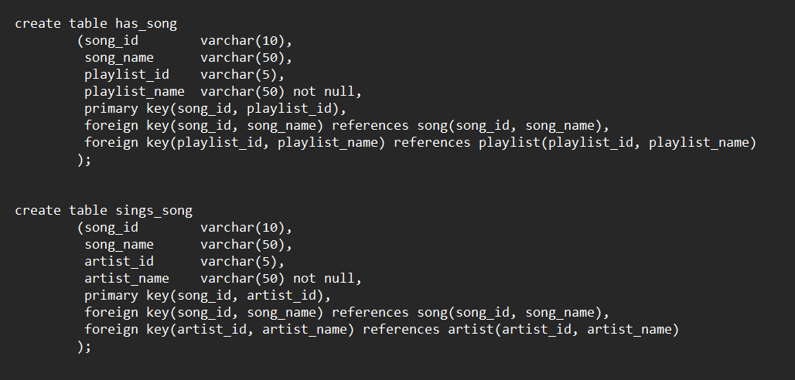
DDL - Relationships

Slide 9
DDL – Relationship Explanation – sings_song
The sings_song relationship connects the song and artist entities through the song_id, song_name, artisti_id and artist_name.
The primary keys are the song_id and artist_id because they will identify any song without duplicates.
All of the attributes are foreign keys.

Slide 10
DDL – Relationship Explanation – has_song
The has_song relationship connects the song and playlist entity through the song_id, song_name, playlist_id and playlist_name attributes.
The primary keys are song_id and playlist_id because those attributes can distinguish any individual relationship without duplicates.
All of the attributes are foreign keys.

Slide 11
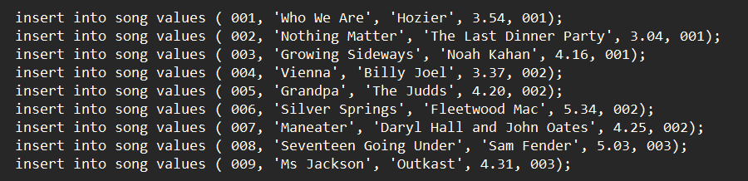
Sample Inserts - Song
I inserted 9 different songs and sorted them into three separate playlists, creating individual ID’s for each song and inputting its duration in minutes.

Slide 12
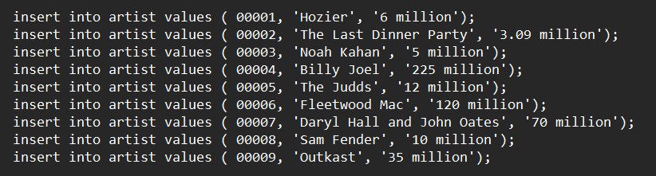
Sample Inserts - Artist
I then created the artists for each song, giving them each an ID and inputting their net worth.

Slide 13

Sample Inserts - Playlist
I created the three different playlists, adding the number of songs in each and giving them names.

Slide 14
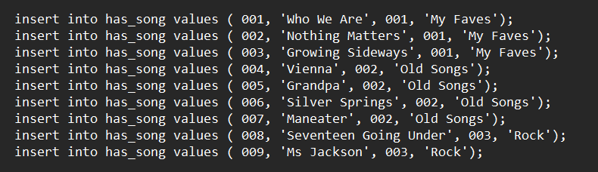
Sample Inserts – has_song
The creation of the relationships, connecting the songs with the playlists.

Slide 15
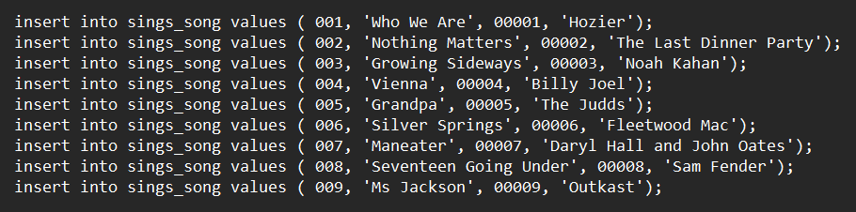
Sample Inserts – sings_song
Creating the relation between the songs and the artists.

Slide 16
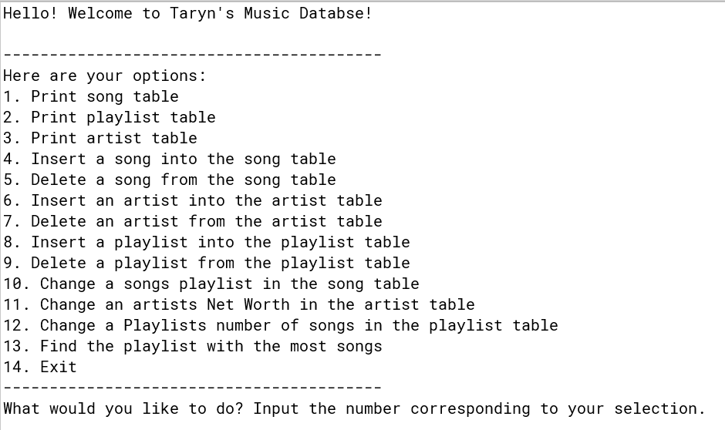
Java Implementation – Initial Look

Slide 17
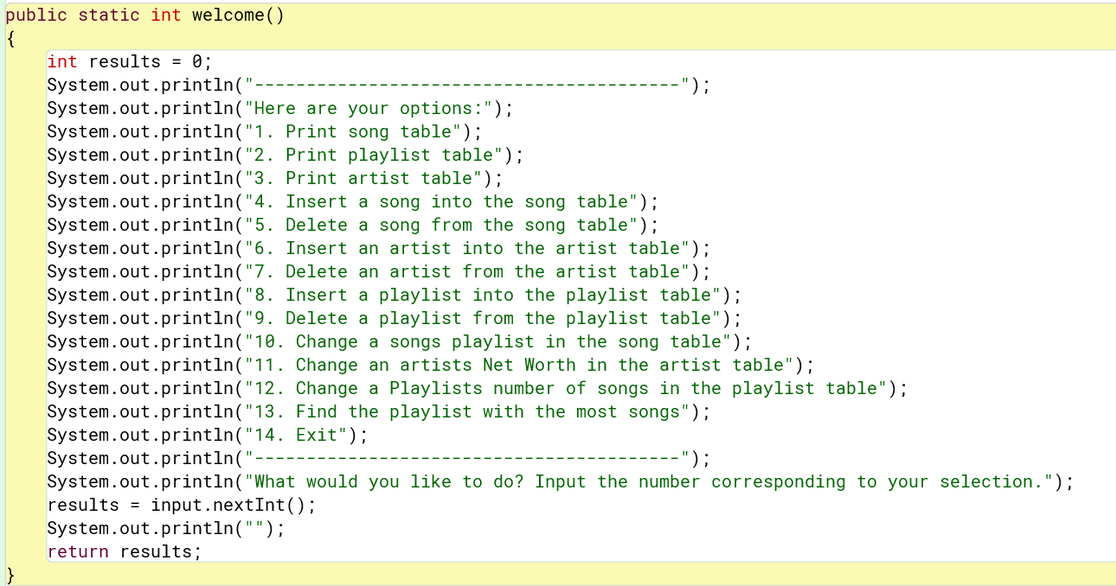
Code Behind the Scenes

Slide 18
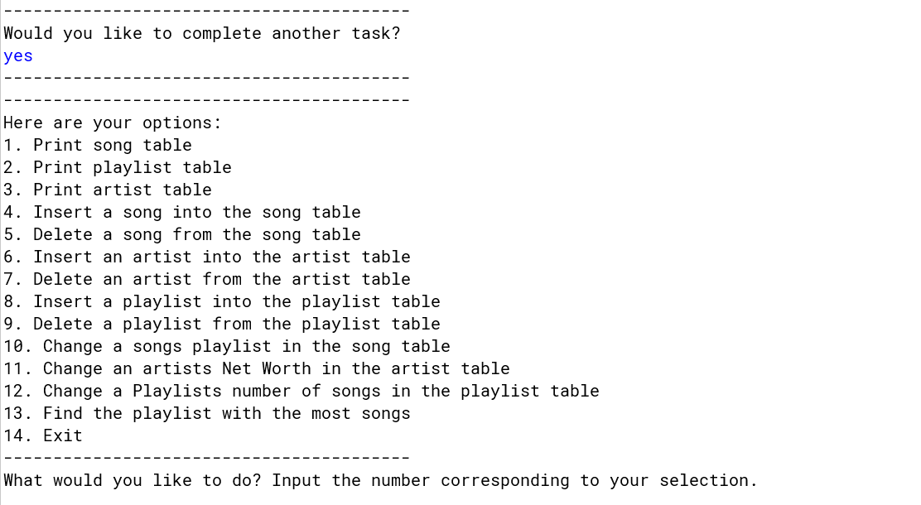
In Between Each Selection

Slide 19
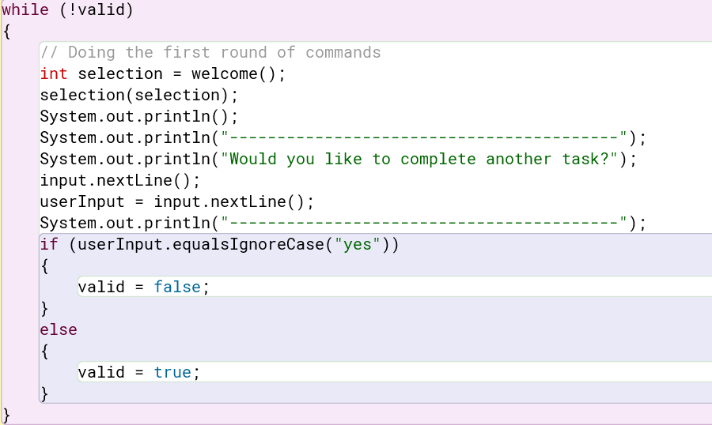
Code Behind the Scenes
This is the loop I created so that the user can continuously work on the database until they decide to exit.

Slide 20
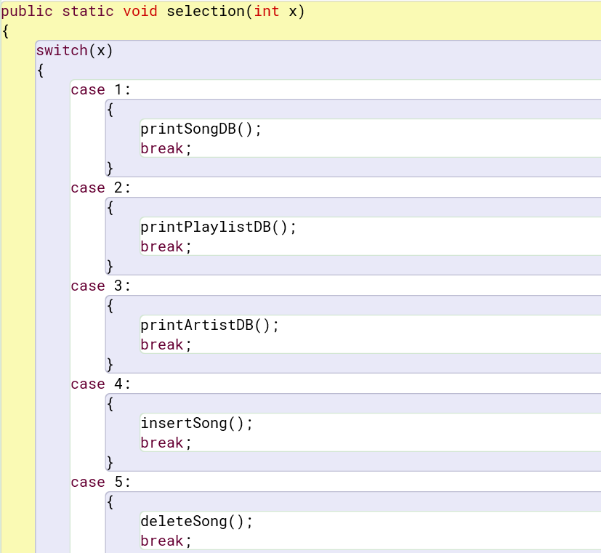
Code Behind the Scenes
I used a large switch case to deal with the user's selection input.

Slide 21
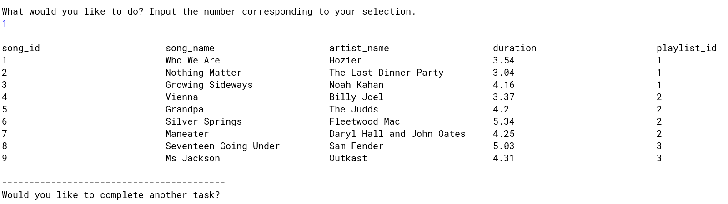
Java Implementation #1 – Printing Song

Slide 22
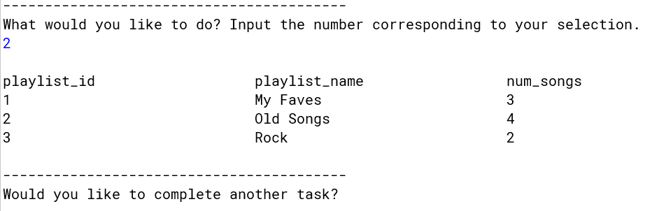
Java Implementation #2 – Printing Playlist

Slide 23
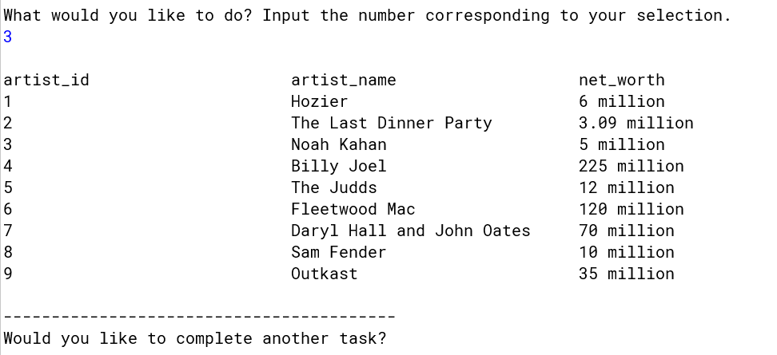
Java Implementation #3 – Printing Artist

Slide 24
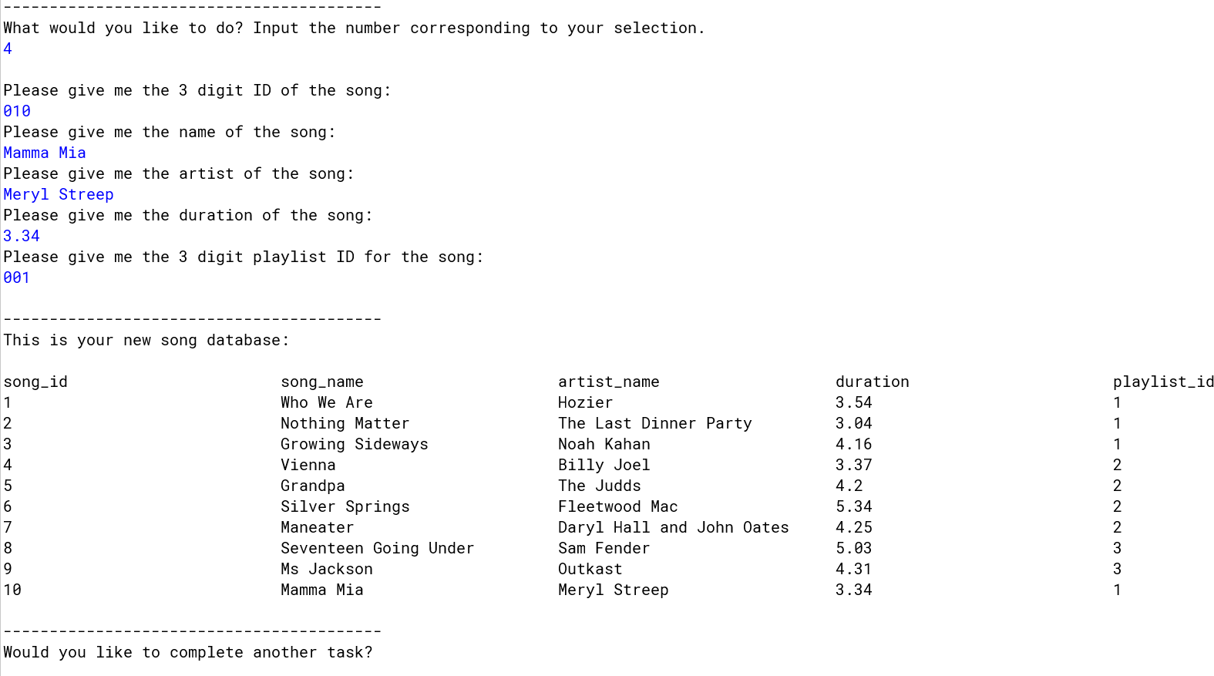
Java Implementation #4 – Inserting Song

Slide 25
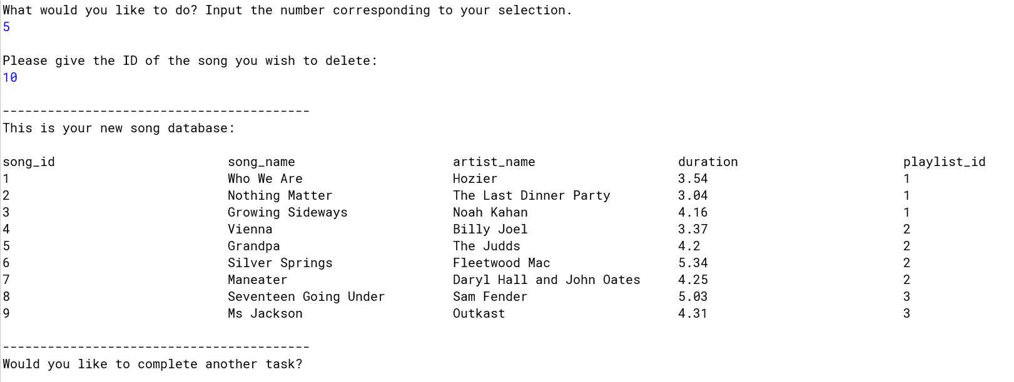
Java Implementation #5 – Deleting Song

Slide 26
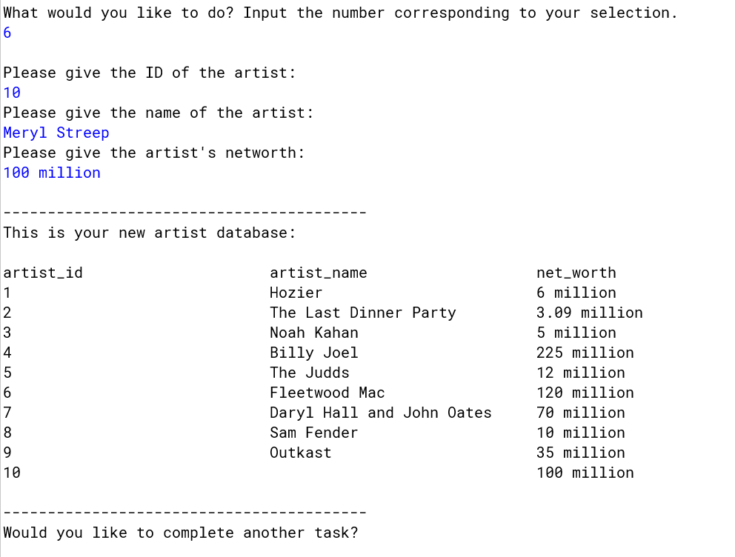
Java Implementation #6 – Inserting Artist

Slide 27
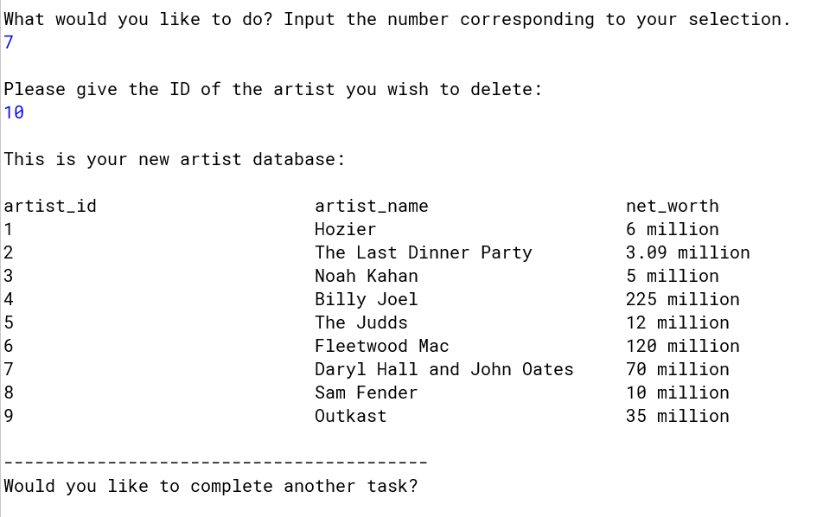
Java Implementation #7 – Deleting Artist

Slide 28
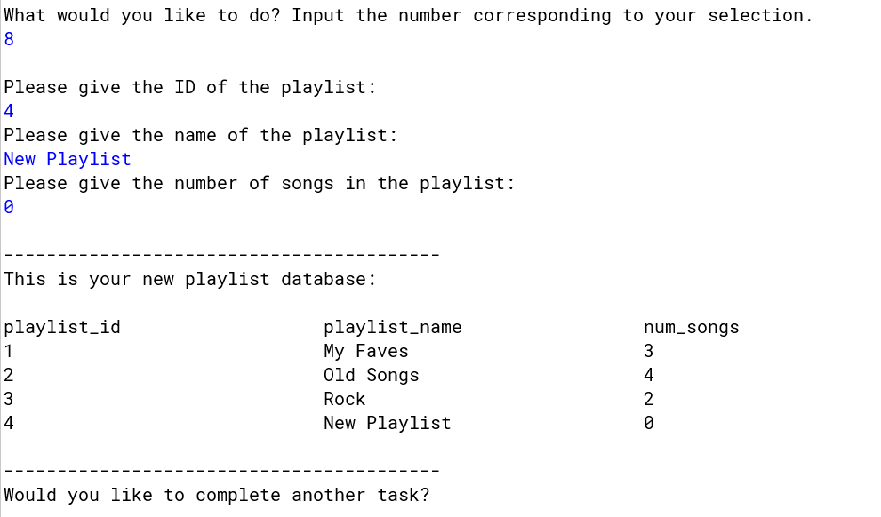
Java Implementation #8 – Inserting a Playlist

Slide 29
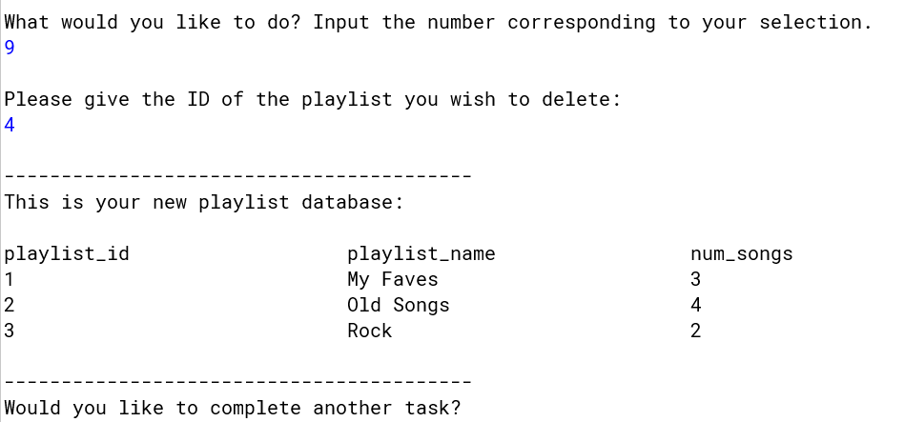
Java Implementation #9 – Deleting a playlist

Slide 30
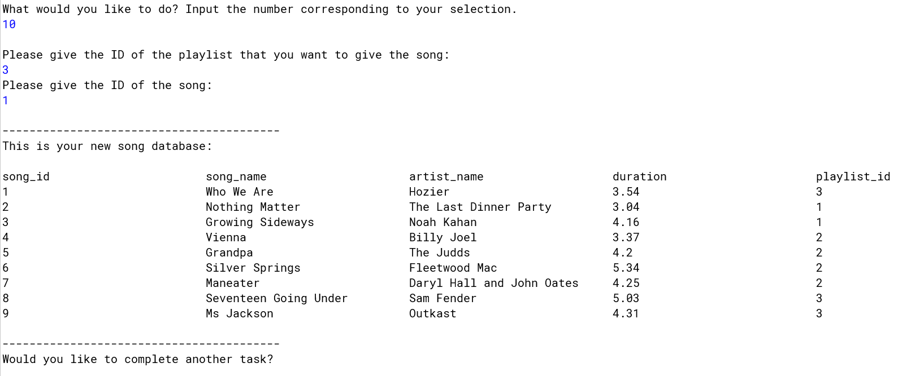
Java Implementation #10 – Changing a songs playlist

Slide 31
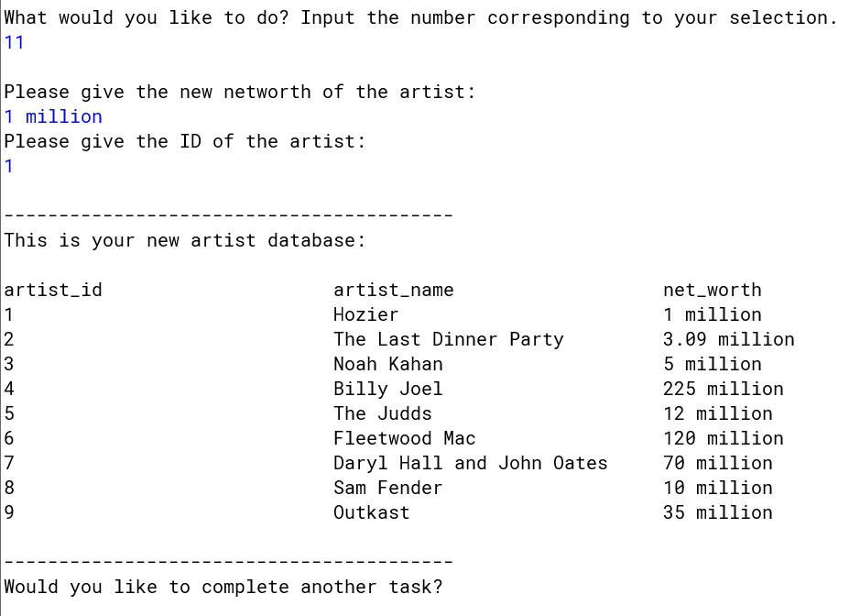
Java Implementation #11 – Changing an Artists Net worth

Slide 32
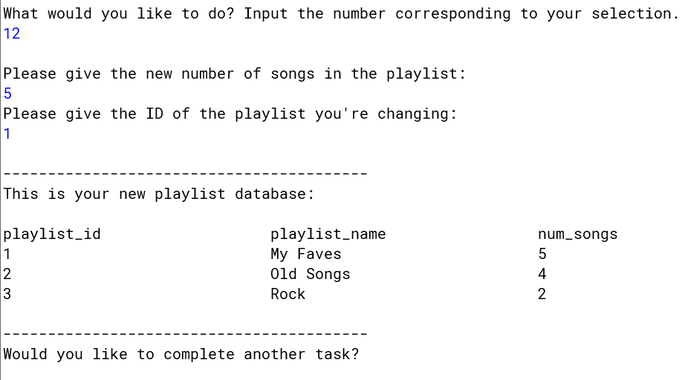
Java Implementation #12 – Changing a Playlists Number of Songs

Slide 33
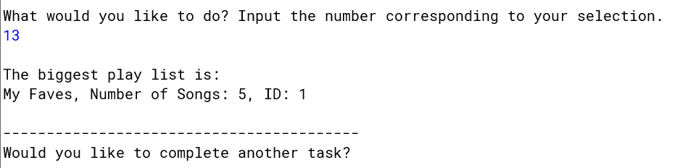
Java Implementation #13 – Finding the playlist with the most songs

Slide 34
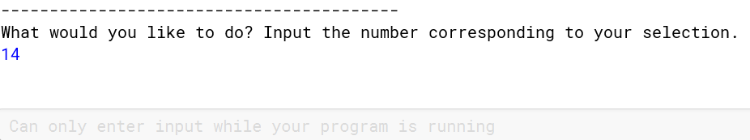
Java Implementation #14 - Exit

Slide 35
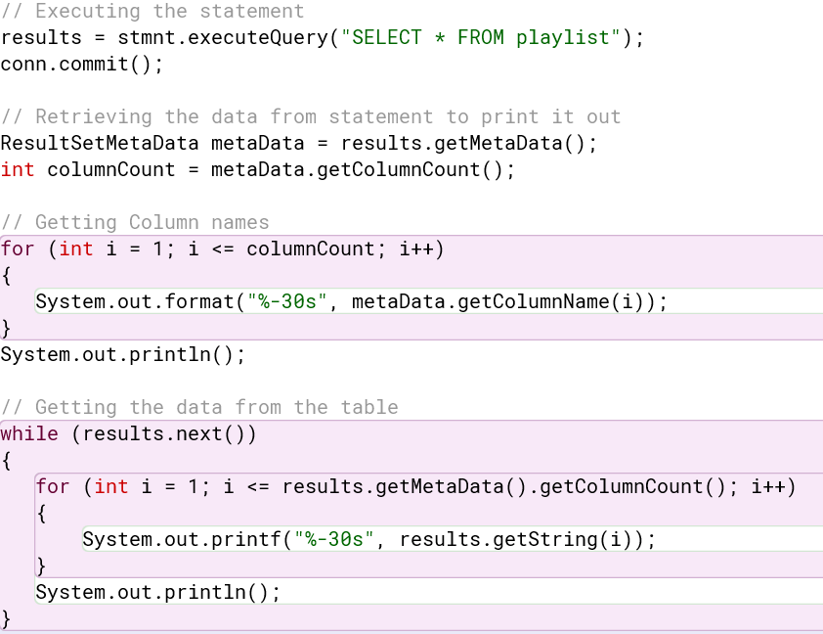
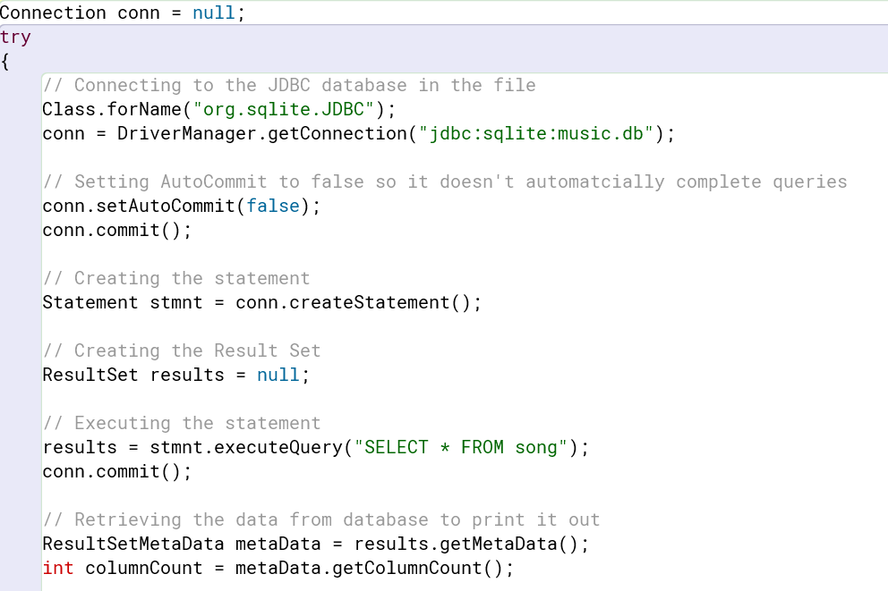
Code Behind the Scenes
I used Result Meta data to manipulate the database and retrieve the results for printing.

Slide 36
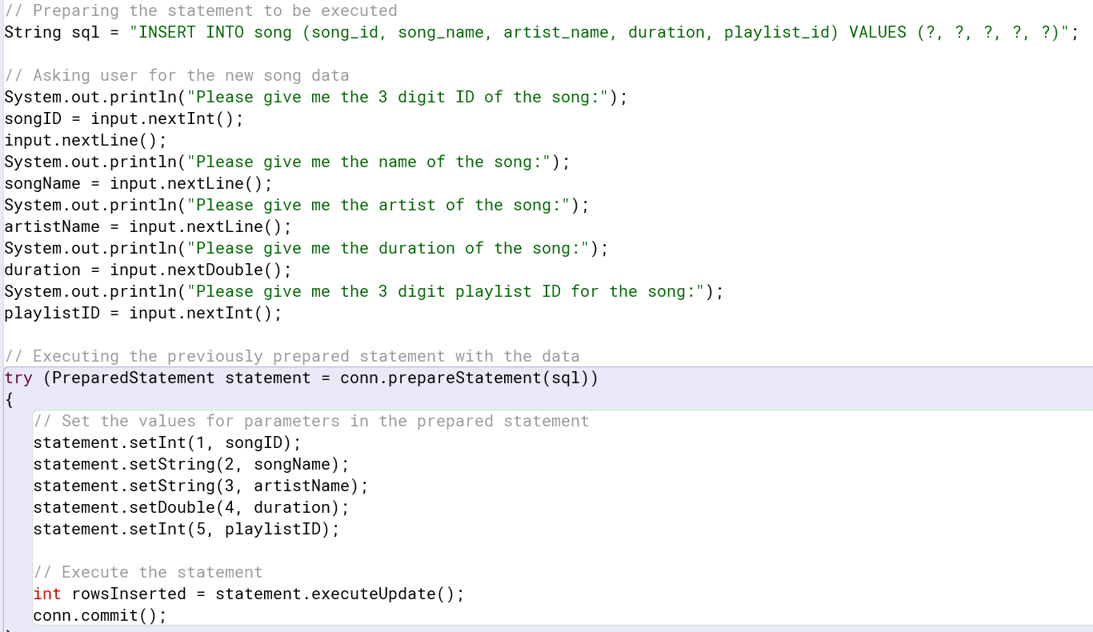
Code Behind the Scenes
I used a Prepared Statement to set up the SQL statement before retrieving the data from the user and executing the Prepared Statement with the inputted values.

Slide 37
Conclusion
My knowledge on databases and implementing them into a JDBC has expanded tenfold. I now know how to link databases and BlueJ as well as use SQL statements in Java to create useful methods for manipulating the database.

Slide 38
Questions?

Slide 39
Bibliography
DatabaseMetaData (Java Platform SE 8 ). (2024, January 8). https://docs.oracle.com/javase/8/docs/api/java/sql/DatabaseMetaData.html
Fadatare, R. (2020, December 12). Java JDBC preparedstatement interface example with mysql database. Java Guides. https://www.javaguides.net/2018/10/jdbc-preparedstatement-interface.html
Package java.sql. java.sql (Java Platform SE 8 ). (2024, January 8). https://docs.oracle.com/javase/8/docs/api/java/sql/package-summary.html
Using prepared statements. Using Prepared Statements (The JavaTM Tutorials > JDBC Database Access > JDBC Basics). (n.d.). https://docs.oracle.com/javase/tutorial/jdbc/basics/prepared.html

